Slide 1
Cloud Computing
SEWP ZG527

Slide 2
Agenda
Cloud Security Issues
Threat Models
Goals of Cloud Computing Security.
Availability
Multi-Tenancy
Service Level Agreements( SLAs)

Slide 3
Introduction to cloud security
If cloud computing is so great, why isn’t everyone doing it?
The cloud acts as a big black box, nothing inside the cloud is visible to the clients
Clients have no idea or control over what happens inside a cloud
Even if the cloud provider is honest, it can have malicious system admins who can tamper with the VMs and violate confidentiality and integrity
Clouds are still subject to traditional data confidentiality, integrity, availability, and privacy issues, plus some additional attacks
Notes:
RL 7.3

Slide 4
Cloud Security Issues
Most security problems stem from:
Loss of Control
Take back control
Data and apps may still need to be on the cloud
But can they be managed in some way by the consumer?
Lack of trust
Increase trust (mechanisms)
Technology
Policy, regulation
Contracts (incentives): topic of a future talk
Multi-tenancy
Private cloud
Takes away the reasons to use a cloud in the first place
VPC: its still not a separate system
Strong separation

Slide 5
Loss of Control in the Cloud
Consumer’s loss of control
Data, applications, resources are located with provider
User identity management is handled by the cloud
User access control rules, security policies and enforcement are managed by the cloud provider
Consumer relies on provider to ensure
Data security and privacy
Resource availability
Monitoring and repairing of services/resources

Slide 6
Multi-tenancy Issues in the Cloud
Conflict between tenants’ opposing goals
Tenants share a pool of resources and have opposing goals
How does multi-tenancy deal with conflict of interest?
Can tenants get along together and ‘play nicely’ ?
If they can’t, can we isolate them?
How to provide separation between tenants?
Cloud Computing brings new threats
Multiple independent users share the same physical infrastructure
Thus an attacker can legitimately be in the same physical machine as the target

Slide 7
Taxonomy of Fear
Confidentiality
Fear of loss of control over data
Will the sensitive data stored on a cloud remain confidential?
Will cloud compromises leak confidential client data
Will the cloud provider itself be honest and won’t peek into the data?
Integrity
How do I know that the cloud provider is doing the computations correctly?
How do I ensure that the cloud provider really stored my data without tampering with it?

Slide 8
Taxonomy of Fear
Availability
Will critical systems go down at the client, if the provider is attacked in a Denial of Service attack?
What happens if cloud provider goes out of business?
Would cloud scale well-enough?
Although cloud providers argue their downtime compares well with cloud user’s own data centers

Slide 9
Taxonomy of Fear (Cont…)
Privacy issues raised via massive data mining
Cloud now stores data from a lot of clients, and can run data mining algorithms to get large amounts of information on clients
Increased attack surface
Entity outside the organization now stores and computes data, and so
Attackers can now target the communication link between cloud provider and client
Cloud provider employees can be phished

Slide 10
Taxonomy of Fear (Cont…)
Auditability and forensics (out of control of data)
Difficult to audit data held outside organisation in a cloud
Forensics also made difficult since now clients don’t maintain data locally
Legal quagmire and transitive trust issues
Who is responsible for complying with regulations?. CSA (Cloud Security Alliance), etc.
If cloud provider subcontracts to third party clouds, will the data still be secure?

Slide 11
Threat Model
Basic components
Attacker modelling
Choose what attacker to consider
insider vs. outsider?
single vs. collaborator?
Attacker motivation and capabilities
Attacker goals

Slide 12
Threat Model (Cont…)
A threat model helps in analyzing a security problem, design mitigation strategies, and evaluate solutions
Steps:
Identify attackers, assets, threats and other components
Rank the threats
Choose mitigation strategies
Build solutions based on the strategies

Slide 13
Cloud Information Security Objectives
Cloud security has unique challenges due to:
Shared infrastructure
Rapid movement of servers and workload in the infrastructure
The basic objectives of cloud security are:
Confidentiality: Prevention of intentional or unintentional unauthorized disclosure of information
Integrity: Modifications are not made to data by unauthorized personnel or processes
Availability: To ensure the reliable and timely access to cloud data or cloud computing resources by the appropriate personnel

Slide 14
Additional Objectives of Cloud Security
These include:
i. Cost-effectiveness: Security implementation should not greatly increase the cost of a cloud solution.
ii. Reliability and performance: These should not be greatly impacted by cloud security.

Slide 15
Cloud Security Services
Factors that directly affect cloud software assurance include are:
Authentication:
-It is about testing the user’s identity and ensures that users are who they claim to be.
-For example, a user presents an identity (user ID) to a computer login screen and then has to provide a password. The computer system authenticates the user by verifying that the password corresponds to the individual presenting the ID.

Slide 16
Cloud Security Services (Cont…)
2) Authorization:
- It refers to rights and privileges granted to an individual or process that enable access to computer resources and information assets.
- Once a user’s identity and authentication are established, authorization levels determine the extent of system rights a user can hold.
3) Auditing:
- To maintain operational assurance, organizations use two basic methods: System audits and Monitoring.
-A system audit is a one-time or periodic event to evaluate security.
- Monitoring refers to an ongoing activity that examines either the system
or the users, such as intrusion detection.

Slide 17
Cloud Security Services (Cont…)
3) Auditing: (Cont…)
IT auditors typically audit the following functions:
System and transaction controls
Systems development standards
Backup controls
Data center security, etc.

Slide 18
Cloud Security Services (Cont…)
Audit Log:
An audit trail or log is a set of records that collectively provide documentary evidence of processing, used to aid in tracing from original transactions forward to related records and reports, and/or backward from records and reports to their component source transactions.
Audit logs should record the following:
The transaction’s date and time
Who processed the transaction
At which terminal the transaction was processed
Various security events relating to the transaction

Slide 19
Cloud Security Services (Cont…)
4. Accountability: It is the ability to determine the actions and behaviors of a single individual within a cloud system and to identify that particular individual.
Audit trails and logs support accountability and can be used to conduct postmortem studies in order to analyze historical events and the individuals or processes associated with those events.
Note: Accountability is related to the concept of nonrepudiation, wherein an individual cannot successfully deny the performance of an action.

Slide 20
Threats and Vulnerabilities
Def (Threat):
- It is simply any event that, if realized, can cause damage to a system and create a loss of confidentiality, availability, or integrity.
- Threats can be malicious, such as the intentional modification of sensitive information, or they can be accidental — such as an error in a transaction calculation or the accidental deletion of a file
Def(Vulnerability):
- A vulnerability is a weakness in a system that can be exploited by a threat.
Reducing the vulnerable aspects of a system can reduce the risk and impact of threats on the system. For example, a password-generation tool, which helps users choose robust passwords, reduces the chance that users will select poor passwords (the vulnerability) and makes the password more difficult to crack (the threat of external attack).

Slide 21
Common Threats to both Cloud and Traditional Infrastructure
Eavesdropping: Data scavenging, traffic or trend analysis, social engineering, economic or political espionage, sniffing, dumpster diving, keystroke monitoring are all types of eavesdropping to gain information or to create a foundation for a later attack. Note: Eavesdropping is a primary cause of the failure of confidentiality.
Fraud — Examples of fraud include collusion, falsified transactions, data manipulation, and other altering of data integrity for gain.
Theft — Examples of theft include the theft of information or trade secrets for profit or unauthorized disclosure, and physical theft of hardware or software.
Sabotage — Sabotage includes denial-of-service (DoS) attacks, production
delays, and data integrity sabotage.
5. External attack — Examples of external attacks include malicious cracking, scanning, and probing to gain infrastructure information, demon dialing to locate an unsecured modem line, and the insertion of a malicious code or virus.

Slide 22
Common types of attacks
Logon Abuse: It refers to legitimate users accessing services of a higher security level that would normally be restricted to them.
Inappropriate System Use: It refers to the nonbusiness or personal use of a network by otherwise authorized users, such as Internet surfing to inappropriate content sites (travel, pornography, sports, and so forth).
Eavesdropping: It is a type of network attack that consists of the unauthorized interception of network traffic.

Slide 23
Common types of attacks (Cont…)
4. Network Intrusion: It refers to the use of unauthorized access to break into a network primarily from an external source. The attackers exploit known security vulnerabilities in the security perimeter.
5. Denial-of-Service (DoS) Attacks:
It occurs when legitimate users are unable to access information systems, devices, or other network resources due to the actions of a malicious attacker.
It is accomplished by flooding the targeted host or network with traffic until the target cannot respond or simply crashes, preventing access for legitimate users
6. Session Hijacking Attacks: It refers to unauthorized access to a system. An attacker hijacks a session between a trusted client and network server.

Slide 24
Cloud Infrastructure Security
The cloud consists of a shared infrastructure that can be rapidly configured on demand to meet business needs.
The cloud infrastructure can be partitioned into:
1) Physical infrastructure
2) Virtual infrastructure.
Based on the above, the security of the cloud infrastructure can be classified as Physical Security and Virtual Security.

Slide 25
Physical Security
It implies that the data center the cloud is hosted in should be secure
against physical threats.
It includes attempts at penetration by intruders, but also protection against natural hazards and disasters such as floods, and human error such as switching off the air conditioning.

Slide 26
Physical Security (Cont…)
Multi-layered system is required to ensure physical security. This includes:
i. A central monitoring and control center with dedicated staff
ii. Monitoring for each possible physical threat, such as intrusion, or natural
hazards such as floods.
iii. Training of the staff in response to threat situations
iv. Manual or automated back-up systems to help contain threats (e.g., pumps to
help contain the damage from floods)
v. Secure access to the facility. This requires that the various threats to the data
center be identified, and appropriate procedures derived for handling these threats.

Slide 27
Virtual Security
Cloud Time Service:
If all systems in the datacenter are synchronized to the same clock, this is helpful both to ensure correct operation of the systems, as well as to facilitate later analysis of system logs. A common way to do this is by use of the Network Time Protocol (NTP).
2) Identity Management:
It is a foundation for achieving confidentiality, integrity and availability.

Slide 28
Virtual Security (Cont…)
3. Access Management:
It is to allow accesses to cloud facilities only to authorized users.
- Not allow unrestricted access to cloud management personnel
- Allow implementation of multi-factor authentication (e.g., use of a password together with a digital key) for very sensitive operations.
4. Key Management:
- In a cloud, with shared storage, encryption is a key technology to ensure isolation of access.
- Need to provide secure facilities for the generation, assignment, revocation, and archiving of keys. It is also necessary to generate procedures for recovering from compromised keys.

Slide 29
Virtual Security (Cont…)
5. Auditing:
Auditing is needed for all system and network components.
The audit should capture all security-related events, together with data needed to analyze the event such as the time, system on which the event occurred, and userid that initiated the event.
The audit log should be centrally maintained and secure.

Slide 30
Virtual Security (Cont…)
6. Security Monitoring:
-This includes an infrastructure to generate alerts when a critical security event has occurred, including a cloud-wide intrusion and anomaly detection system.
7. Security Testing:
Test all software for security before deployment in an isolated test bed.
Patches to software should also be tested in this environment before being released into production.

Slide 31
Virtual Threats
Many VM vulnerabilities stem from the fact that a vulnerability in one VM system can be exploited to attack other VM systems or the host systems, as multiple virtual machines share the same physical hardware.
Type 2 Virtualized Environment

Slide 32
Virtual Threats (Cont…)
1. Shared clipboard — It allows data to be transferred between VMs and the host, providing a means of moving data between malicious programs in VMs of different security realms.
2. Keystroke logging — Some VM technologies enable the logging of keystrokes and screen updates to be passed across virtual terminals in the virtual machine, writing to host files and permitting the monitoring of encrypted terminal connections inside the VM.

Slide 33
Virtual Threats (Cont…)
3. VM monitoring from the host: Because all network packets coming from or going to a VM pass through the host, the host may be able to affect the VM by various ways such as Monitoring and configuring resources available to the VMs, including CPU, memory, disk, and network usage of VMs.

Slide 34
Virtual Threats (Cont…)
4. Virtual machine monitoring from another VM — Suppose if the VM platform uses a virtual hub or switch to connect the VMs to the host, then intruders may be able to use a hacker technique known as “ARP poisoning” to redirect packets going to or from the other VM for sniffing.
5. Virtual machine backdoors — A backdoor, covert communications channel between the guest and host could allow intruders to perform potentially dangerous operations.

Slide 35
Hypervisor Risks
The hypervisor is the part of a virtual machine that allows host resource sharing and enables VM/host isolation.
The ability of the hypervisor to provide the necessary isolation during intentional attack greatly determines how well the virtual machine can survive risk.
Why the hypervisor is susceptible to risk?
Because it’s a software program; risk increases as the volume and complexity of application code increases.

Slide 36
VM Security Recommendations
Best Practice Security Techniques: These areas include physical security, patching, and remote management techniques.
i) Hardening the Host Operating System: Vulnerabilities inherent in the operating system of the host computer can flow upward into the virtual machine operating system.
- A compromise of the underlying host OS would give an intruder access to all services on all virtual machines hosted by the machine.
Techniques to maintain the security posture of the underlying technology:
Use strong passwords, such as lengthy, hard to guess passwords with letters, numbers, and symbol combinations, and change them often.
Disable unneeded services or programs, especially networked services.
Require full authentication for access control.
The host should be individually firewalled.
Patch and update the host regularly, after testing on a nonproduction unit.

Slide 37
Limiting Physical Access to the Host: It is required to prevent intruders from attacking the hardware of the virtual machine. When attackers can access a host they can do the following:
Use OS-specific keystrokes to kill processes, monitor resource usage, or shut down the machine, commonly without needing a valid login account and password

Slide 38
Identity Management
Note: Identification and authentication are the keystones of most access control systems.
Def(Identification):
It is the act of a user professing an identity to a system, usually in the form of a username or user logon ID to the system.
It establishes user accountability for the actions on the system.
User IDs should be unique and not shared among different individuals.
User IDs follow set standards, such as first initial followed by last name, and so on.
An ID should not reflect the user’s job title or function in order to enhance security and reduce the amount of information available to an attacker.

Slide 39
Identity Management
Def(Authentication):
It is verification that the user’s claimed identity is valid, and it is usually implemented through a user password at logon.
Authentication is based on the following three factor types:
-Type 1 — Something you know, such as a personal identification number (PIN) or password
-Type 2 — Something you have, such as an ATM card or smart card
-Type 3 — Something you are (physically), such as a fingerprint or retina scan

Slide 40
Two Factor Authentication
It requires two of the three factors to be used in the authentication process.
For example, withdrawing funds from an ATM machine requires two-factor authentication in the form of the ATM card (something you have) and a PIN number (something you know).

Slide 41
Password
Passwords must be protected.
In the ideal case, a password should be used only once. This “one-time password,” or OTP, provides maximum security because a new password is required for each new logon.
A password that is the same for each logon is called a static password.
A password that changes with each logon is termed a dynamic password.
A front-end authentication device or a back-end authentication server, which services multiple workstations or the host can perform the authentication.
Passwords can be provided by a number of devices, including tokens, memorycards, and smart cards.
Note: Passwords can be required to change monthly, quarterly, or at other intervals, depending on the criticality of the information needing protection and the password’s frequency of use.
Note: Tokens, in the form of small, hand-held devices, are used to provide passwords.

Slide 42
Biometrics
It is an alternative to using passwords for authentication.
Biometrics is based on the Type 3 authentication mechanism.
Biometrics is defined as an automated means of identifying or authenticating the identity of a living person based on physiological or behavioral characteristics.
Identification in biometrics is a one-to-many search of an individual’s characteristics from a database of stored images while Authentication is a one-to-one search to verify a claim to an identity made by a person.
Biometrics is used for identification in physical controls and for authentication in logical controls.

Slide 43
Biometrics (Cont…)
Three main performance measures in biometrics
1. False rejection rate (FRR) or Type I Error : The percentage of valid
subjects that are falsely rejected.
2. False acceptance rate (FAR) or Type II Error : The percentage of invalid subjects that are falsely accepted.
3. Crossover error rate (CER) : The percentage at which the FRR equals
the FAR. The smaller the CER, the better the device is performing.

Slide 44
Biometrics (Cont…)
Typical biometric characteristics that are used to uniquely authenticate an individual’s identity:
Fingerprints — Fingerprint characteristics are captured and stored. Typical CERs are 4–5%.
Retina scans — The eye is placed approximately two inches from a camera and an invisible light source scans the retina for blood vessel patterns. CERs are approximately 1.4%.
Iris scans — A video camera remotely captures iris patterns and characteristics. CER values are around 0.5%.
Hand geometry — Cameras capture three-dimensional hand characteristics. CERs are approximately 2%.
Voice — Sensors capture voice characteristics, including throat vibrations and air pressure, when the subject speaks a phrase. CERs are in the range of 10%.
Note: Other types of biometric characteristics include facial and palm scans.

Slide 45
Implementing Identity Management
Establishing a database of identities and credentials
Managing users’ access rights
Enforcing security policy
Developing the capability to create and modify accounts
Setting up monitoring of resource accesses
Installing a procedure for removing access rights
Providing training in proper procedures

Slide 46
Access Control
Access control is intrinsically tied to identity management and is necessary to preserve the confidentiality, integrity, and availability of cloud data.
Three things that must be considered for the implementation of access control mechanisms: Threats to the system, the system’s vulnerability to these threats, and the risk (potential for harm or loss to an information system or network) that the threats might materialize.
Benefits of access control: Keep Track of Employees, Reduce Theft and Accidents, Secure Sensitive Documents and Data, etc.

Slide 47
Controls
Controls are implemented to mitigate risk and reduce the potential for loss.
Two important concepts of Controls: Separation of duties and the principle of least privilege.
Def(Separation of duties): It requires an activity or process to be performed by two or more entities for successful completion. Thus, the only way that a security policy can be violated is if there is collusion among the entities.
Any example could you provide?.
For example, in a financial environment, the person requesting that a check be issued for payment should not also be the person who has authority to sign the check.
Def(Least privilege): The minimum resources and privileges required to complete the task for the minimum necessary period of time.

Slide 48
Control Measures
Control measures can be administrative, logical (also called technical), and physical in their implementation. They are:
Administrative controls include policies and procedures, security awareness training, background checks, work habit checks, a review of vacation history, and increased supervision.
Logical or technical controls involve the restriction of access to systems and the protection of information. Examples of these types of controls are encryption, smart cards, access control lists, and transmission protocols.
Physical controls incorporate guards and building security in general, such as the locking of doors, the securing of server rooms or laptops, the protection of cables, the separation of duties, and the backing up of files.

Slide 49
Models for Controlling Access
Controlling access by a subject (an active entity such as an individual or process) to an object (a passive entity such as a file) involves setting up access rules. These rules can be classified into three categories or models. They are:
Mandatory Access Control
Discretionary Access Control
Nondiscretionary Access Control

Slide 50
1. Mandatory Access Control
The authorization of a subject’s access to an object depends upon labels, which indicate the subject’s clearance, and the classification or sensitivity of the object.
For example, the military classifies documents as unclassified,
confidential, secret, and top secret.
Similarly, an individual can receive a clearance of confidential, secret, or top secret and can have access to documents classified at or below his or her specified clearance level. Thus, an individual with a clearance of “secret” can have access to secret and confidential documents with a restriction.
Rule-based access control is a type of mandatory access control because rules determine this access (such as the correspondence of clearance labels to classification labels), rather than the identity of the subjects and objects alone.

Slide 51
2. Discretionary Access Control
It allows to decide on who can access which areas of the premises or resources.
In this model, the subject has authority, within certain limitations, to specify what objects are accessible.
For example, access control lists (ACLs) can be used.
An access control list is a list denoting which users have what privileges to a particular resource.
For example, a tabular listing would show the subjects or users who have access to the object, e.g., file X, and what privileges they have with respect to that file.

Slide 52
2. Discretionary Access Control (Cont…)
An access control triple consists of the user, program, and file, with the corresponding access privileges noted for each user.
This type of access control is used in local, dynamic situations in which the subjects must have the discretion to specify what resources certain users are permitted to access.
When a user within certain limitations has the right to alter the access control to certain objects, this is termed a user-directed discretionary access control.
An identity-based access control is a type of discretionary access control based on an individual’s identity.
-It determines what you can do based on who you are.
- The user performing an API request is first authenticated and then a check is performed to see if that user is authorized to perform the action they’re requesting.
- In some instances here, a hybrid approach is used, which combines the features of user-based and identity-based discretionary access control.

Slide 53
3. Nondiscretionary Access Control
Here, a central authority determines which subjects can have access to certain objects based on the organizational security policy.
The access controls are decided based on the individual’s role in the organization (Role-based access control) or the subject’s responsibilities and duties (task-based).
It is useful in organizations frequent personnel changes occur as the access controls are based on the individual’s role or title within the organization. Therefore, these access controls don’t need to be changed whenever a new person assumes that role.

Slide 54
3. Nondiscretionary Access Control (Cont…)
Access control can also be characterized as context-dependent or content-dependent.
Context-dependent access control is a function of factors such as location, time of day, and previous access history. It is concerned with the environment or context of the data.
In content-dependent access control, access is determined by the information contained in the item being accessed.

Slide 55
How do you deal with the security threats from the Cloud Service Providers themselves (Insider Attackers)?
Can anyone suggest any solution in this context?.
Solution:
Store encrypted data at the cloud servers instead of plaintext form. This guarantees security but complicates data retrieval operation.
Does anyone know anything approach that would guarantee data security and yet simplifies the retrieval operation.?.
Solution: Searchable Encryption
It is a cryptographic paradigm that enables the cloud server to perform search operation over encrypted data without knowing anything about plaintext information.

Slide 56
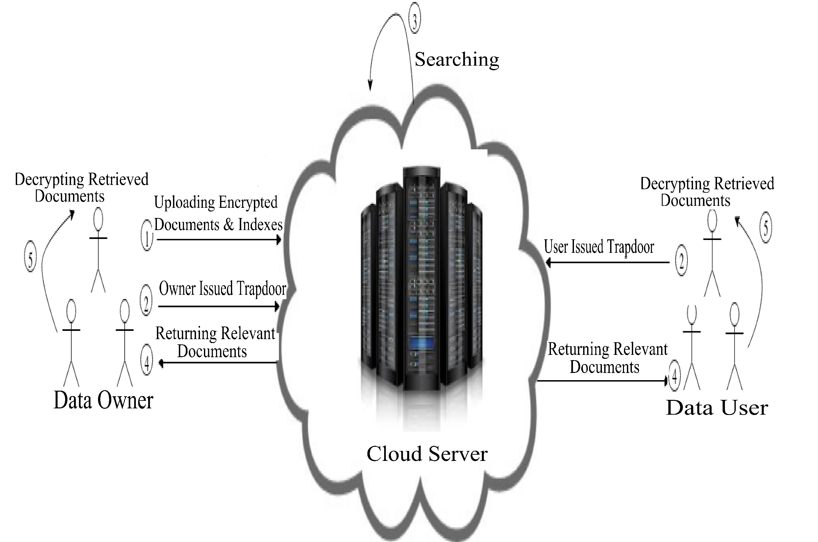
Searchable Encryption Process

Slide 57
Will searchable encryption resolves all security issues because of storing encrypted data at cloud servers.?
No, there are still various security issues associated with the following information disclosure attacks:
Frequency Analysis Attacks (Frequency leakage).
Scale Analysis Attacks (Search pattern leakage).
Rank-order Exploitation Attacks (rank information leakage)
Access Pattern Exploitation Attacks (Access pattern leakage)
Keyword Guessing Attacks.

Slide 58
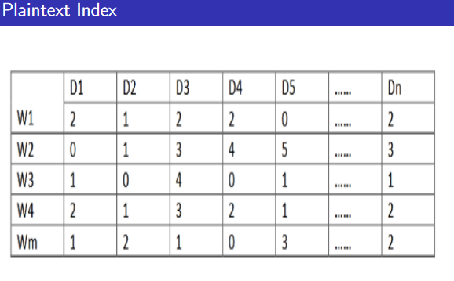
Observe Frequency of Plaintext values of various keywords

Slide 59
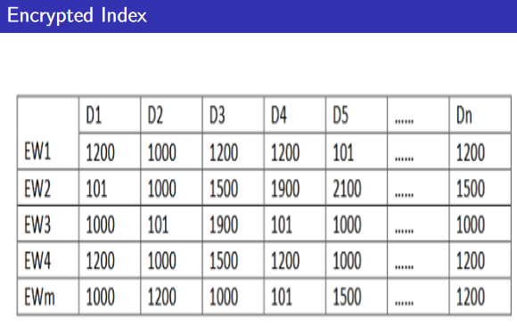
Observe Frequency of ciphertext values of corresponding keywords
Assume Order-Preserving Encryption schemes are used to encrypt the plaintext values of keywords in indexes.
Frequency Leakage allows us to infer plaintext keyword from the encrypted values of encrypted index.

Slide 60
The insider attackers mount the various attacks (discussed) and infer plaintext information from the encrypted information with the help of some background knowledge about the stored data.
Mitigating or Preventing the information disclosure attacks:
We need to combine various privacy-preserving searchable encryption approaches based on privacy, precision and efficiency requirements.
Note: Searchable encryption approaches can provide benefits to both the data owners and as well as Cloud service Providers (CSPs).

Slide 61
Availability
Ensuring high availability is important for both mission-critical and non-mission critical applications, as the downtime implies loss of revenue.
Availability can be ensured using two approaches:
1. High availability for underlying application
2. Build support for high availability into infrastructure
1) High availability for the underlying application involves following three techniques: They are:
i) Infrastructure Availability: It ensures redundancy in infrastructure, such as servers, so that new servers are always ready to replace filed servers.
ii) Middleware Availability: It deals with middleware redundancy.
iii) Application Availability: It is achieved using application redundancy.

Slide 62
2) Build Support for the High Availability into the Infrastructure
Two types of support can be built into the infrastructure:
Failure detection:
- The cloud infrastructure detects failed application instances, and avoids routing requests to such instances.
-Many CSPs such as AWS Elastic BeanStalk, detect when an application instance fails, and avoid sending new requests to the failed instance.
- To detect failures, It is required to monitor for failures: Two techniques are used:
i) Heartbeats:
-The application instance periodically sends a signal (called a heartbeat) to a monitoring service in the cloud.
-If the monitoring service does not receive a specified number of consecutive heartbeats, it may declare that the application instance as failed.
ii) Probes:
-The monitoring service periodically sends a probe, which is a lightweight service request to the application instance.
- If the instance does not respond to a specified number of probes, it may be considered failed.
- Redirection: After identifying failed instances, it is necessary to avoid routing new requests to the failed instances.
- HTTP-Redirection: The web server may return a 3xx return together with a new URL to be visited.
- For example, if a user types http://www.pustaportal.com/ into their browser, the request first be sent to a load-balancing service at Pustak Portal, which may return a return code of 302 with a URL http://pps5.pustakportal.com. (pp5.pustakportal.com is the address of a server that is currently known to be up.)

Slide 63
2) Application Recovery:
It is necessary to recover old requests in addition to directing new requests to a server that is up.
Checkpoint/Restart: The cloud infrastructure periodically saves the state of the application. If the application determined to have failed, the most recent check point can be activated and the application can resume from that state.
- The infrastructure should check point all resources(e.g., system memory)
-Checkpointing storage will normally require support from the storage or file system, since any updates that were performed have to be rolled back.
- Distributed checkpoint/restart: All processes of distributed application instances are checkpointed, and all instances are restarted from a common check-point if any instance fails.

Slide 64
Service Level Agreement (SLA)
A cloud service SLA is a document defining the agreement or interaction between the customer and the cloud server provider.
An SLA must contain list of services, metrics to evaluate (response time, outages per month, N/W and Storage throughput), mechanism to monitor the service, remedies or credits to be given if terms of SLA are not met, expected changes in SLA over time, roles and responsibilities of customer, etc.
Cloud providers offer the following types of SLA:
- Off-the-Shelf SLAs: This can be found on their website. They offer credits toward the monthly bill for SLA violations. They are non-negotiable and usually unacceptable to enterprises wanting to host critical services on the cloud.
-Negotiable SLAs: There are more expensive, because they are customized for the client.

Slide 65
Service Level Objective (SLO)
SLO is part of SLA that defines the characteristic of a service in specific and quantifiable terms.
Some examples:
- Application must not have more than 15 pending requests at any instant.
- Response for a read request should initiate within 3 seconds.
- Data must be stored within the Bangalore and Mumbai data centers.

Slide 66
SLA Aspects and Requirements
There are various considerations that must be specified within an SLA. Some of the key elements that help make a compact SLA are described below:
Service Availability
Data Locations
Availability Zones
Downtime Credits
Credit Initiation
Mean Time to Repair
Data Protection
Data Encryption
Regulator Requirements
Certifications
Scheduled Maintenance Perios

Slide 68
Multitenancy – Introduction
Multi-tenancy is an architecture in which a single instance of a software application serves multiple customers. Each customer is called a tenant. Tenants may be given the ability to customize some parts of the application, such as color of the user interface (UI) or business rules, but they cannot customize the application's code.
A software-as-a-service (SaaS) provider, for example, can run one instance of its application on one instance of a database and provide web access to multiple customers. In such a scenario, each tenant's data is isolated and remains invisible to other tenants.
Notes:
http://www.rightscale.com/blog/enterprise-cloud-strategies/four-steps-achieving-high-availability-cloud

Slide 69
Multitenancy – Introduction
Multi-tenancy is an architectural pattern
A single instance of the software is run on the service provider’s infrastructure
Multiple tenants access the same instance.
In contrast to the multi-user model, multi-tenancy requires customizing the single instance according to the multi-faceted requirements of many tenants.

Slide 70
Multitenancy – key aspects
A Multi-tenants application lets customers (tenants) share the same hardware resources, by offering them one shared application and database instance ,while allowing them to configure the application to fit there needs as if it runs on dedicated environment.
These definition focus on what we believe to be the key aspects of multi tenancy:
The ability of the application to share hardware resources.
The offering of a high degree of configurability of the software.
The architectural approach in which the tenants make use of a single application and database instance.

Slide 71
Multi-tenants Deployment Modes for Application Server
Fully isolated Application server Each tenant accesses an application server running on a dedicated servers.
Virtualized Application Server Each tenant accesses a dedicated application running on a separate virtual machine.
Shared Virtual Server Each tenant accesses a dedicated application server running on a shared virtual machine.
Shared Application Server The tenant shared the application server and access application resources through separate session or threads.
Application Server
Tenant A
Tenant B
Application server
Application server
Virtual machine
Tenant A
Virtual machine
Tenant B
Application server
Tenant A
Virtual machine
Tenant B
Session thread
Tenant A
Application Server
Tenant B
Session Thread

Slide 72
Multi-tenants Deployment Modes in Data Centers
Fully isolated data center The tenants do not share any data center resources
Virtualized servers The tenants share the same host but access different databases running on separate virtual machines
Shared Server The tenants share the same server (Hostname or IP) but access different databases
Shared Database The tenants share the same server and database (shared or different ports) but access different schema(tables)
Shared Schema The tenants share the same server, database and schema (tables). The irrespective data is segregated by key and rows.
Tenant A
Tenant B
Virtual
Machine
Database
Tenant A
Virtual
Machine
Database
Tenant B
Tenant A
Tenant B
Tenant A
Tenant B
Tenant A
Tenant B

Slide 73
References
Ronald L. Krutz, Russell Dean Vines, “Cloud Security: A Comprehensive Guide to Secure Cloud Computing”, Wiley-India, 2010.
Dinkar Sitaram and Geetha Manjunath. Moving to the Cloud. Syngress (Elsevier) Pub, 2011
https://github.com/CryptDB/cryptdb (Encrypted database)
https://dl.acm.org/doi/10.1145/2636328 (Searchable Encryption)
https://www.sciencedirect.com/science/article/pii/S0306437917303824 (Searchable encryption)
https://www.sciencedirect.com/topics/computer-science/external-attacker (External attackers)

Slide 74
Thank you all.

